Slide 1
Build your first AI Assistant using generative AI
Forget the hype. Let’s explore some capabilities of Generative AI (LLM) that we can map to our business requirements and client's needs.
Alexandru Lungu, Senior Software Developer | Full-Stack

Slide 2
Agenda
Generative AI capabilities
Implement a real AI assistant using one of the LLM capabilities: RAG (Retrieval-Augmented Generation)
Q&A

Slide 3


Slide 4
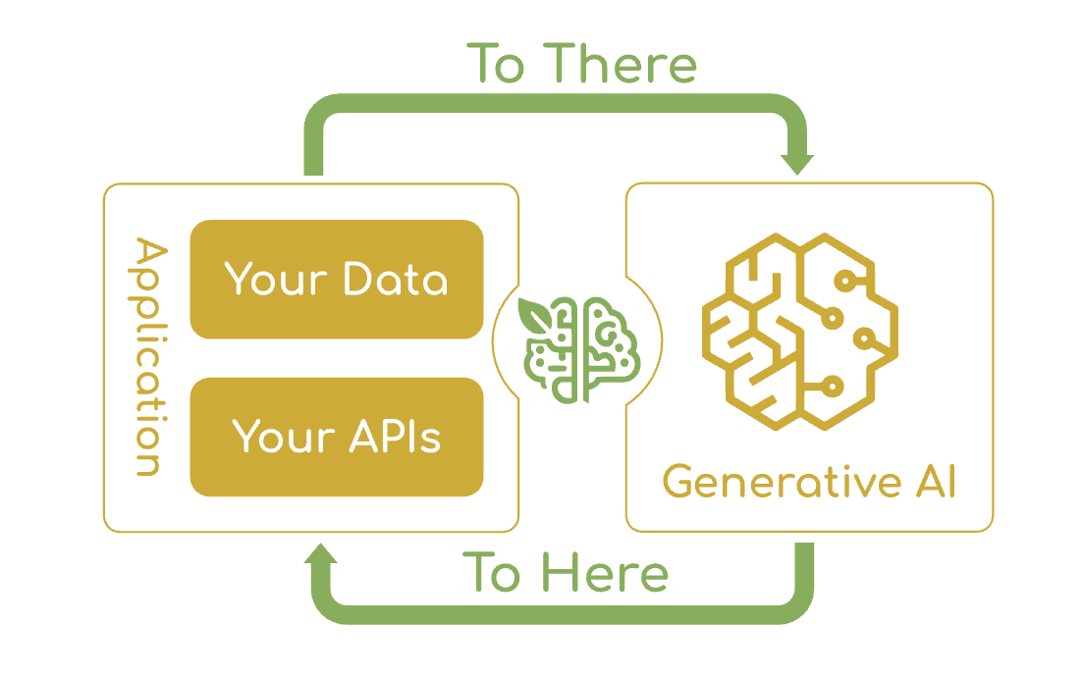
Spring AI (framework)
The Spring AI project aims to streamline the development of applications that incorporate artificial intelligence functionality without unnecessary complexity.
The project draws inspiration from notable Python projects, such as LangChain, LlamaIndex, Langchain4J

Slide 5
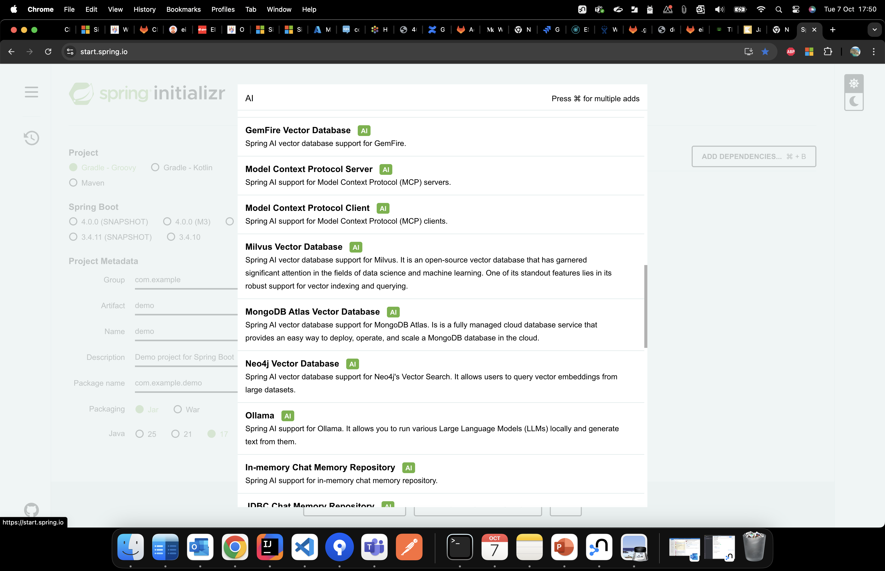
Spring AI (framework)

Slide 6
Spring AI - capabilities
Support for all major AI Model providers such as Anthropic, OpenAI, Microsoft, Amazon, Google, and Ollama.
Supported model types include:
Chat Completion
Embedding
Text to Image
Audio Transcription
Text to Speech
Moderation
Structured Outputs - Mapping of AI Model output to POJOs.
Support for all major Vector Database providers
Tools/Function Calling - Permits the model to request the execution of client-side tools and functions, thereby accessing necessary real-time information as required and taking action.
Observability - Provides insights into AI-related operations.
Document ingestion ETL framework for Data Engineering. (document preprocessor for RAG)
AI Model Evaluation - Utilities to help evaluate generated content and protect against hallucinated response
Support for Chat Conversation Memory and RAG

Slide 7
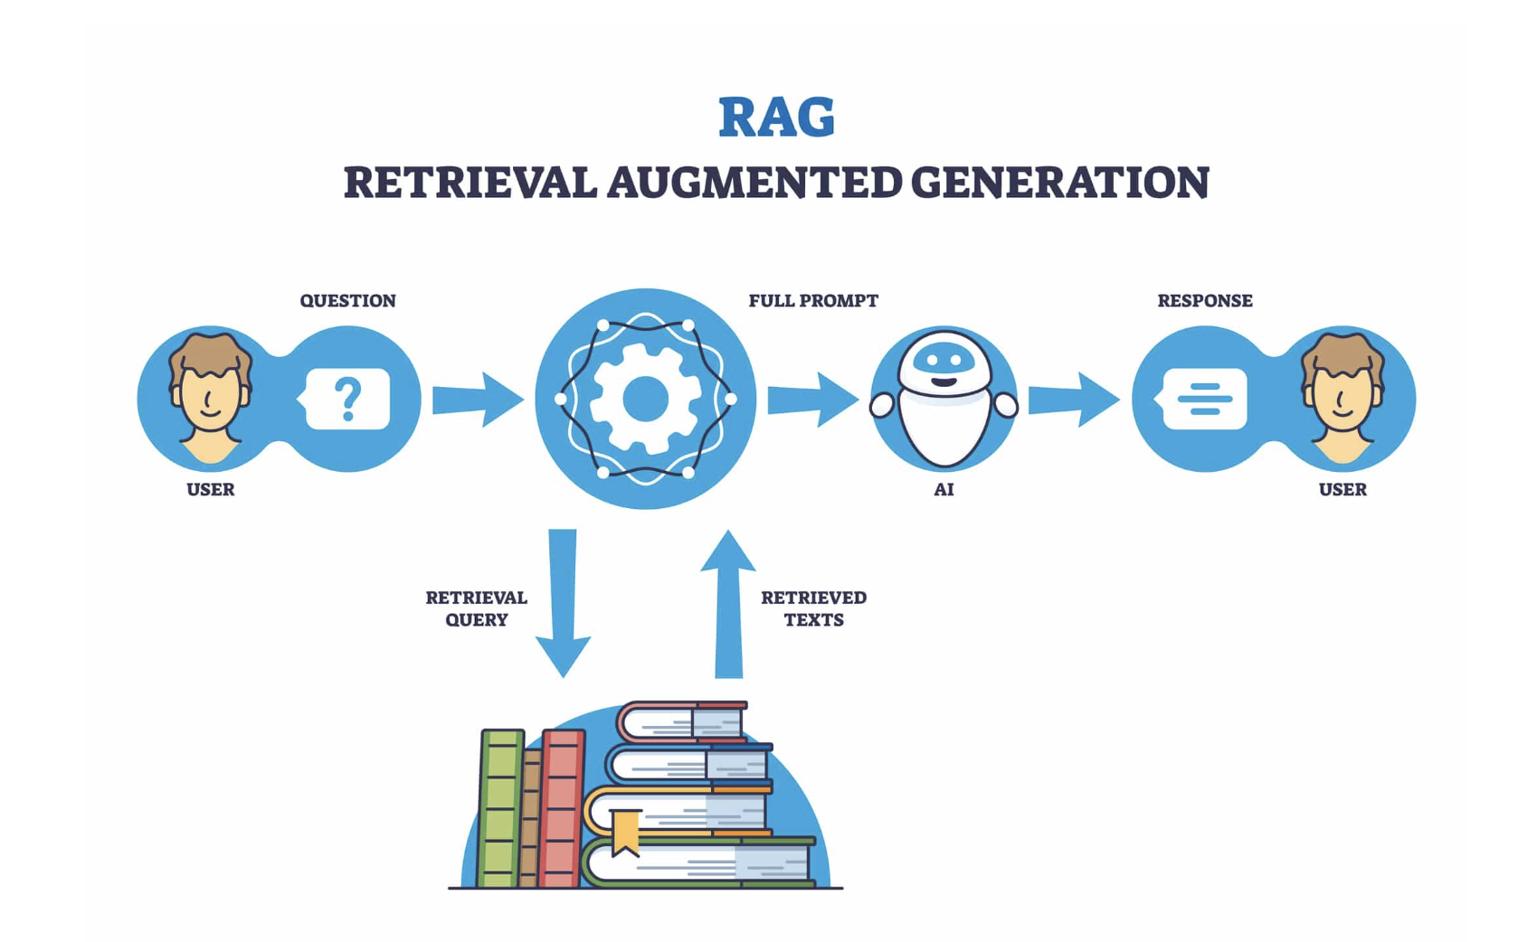
RAG system

Slide 8
Ollama + RAG = AI Assistant
Business usecase:
We want to ask questions to the AI Assistant about a building, and to retrieve information about the infrastructure,
or the power consumption, or different business usecases.
The user can be a technical operator, a manager or a normal user.
The questions will be in natural language.

Slide 9
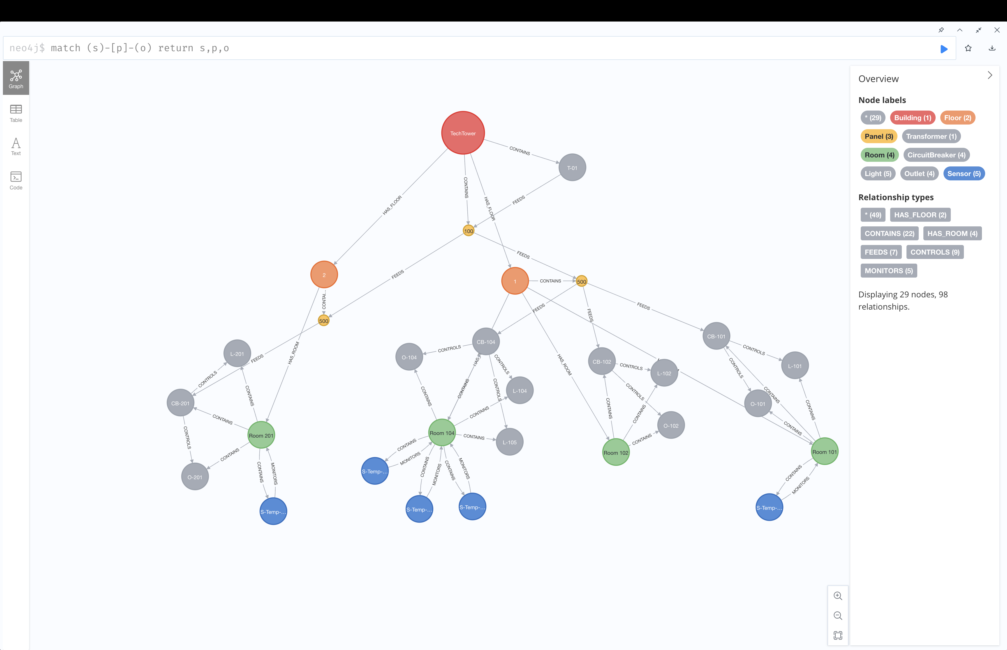
Neo4J – Building model as a knowledge graph (graph database)

Slide 10
Ollama + RAG = AI Assistant
Question #1: get all the Light devices and display the room, Light type and Light type counter
Answer:
| Room | Light Type | Light Type Counter |
|----------|------------|--------------------|
| Room 101 | LED | 1 |
| Room 104 | LED | 2 |
| Room 102 | LED | 1 |
| Room 201 | Fluorescent | 1 |

Slide 11
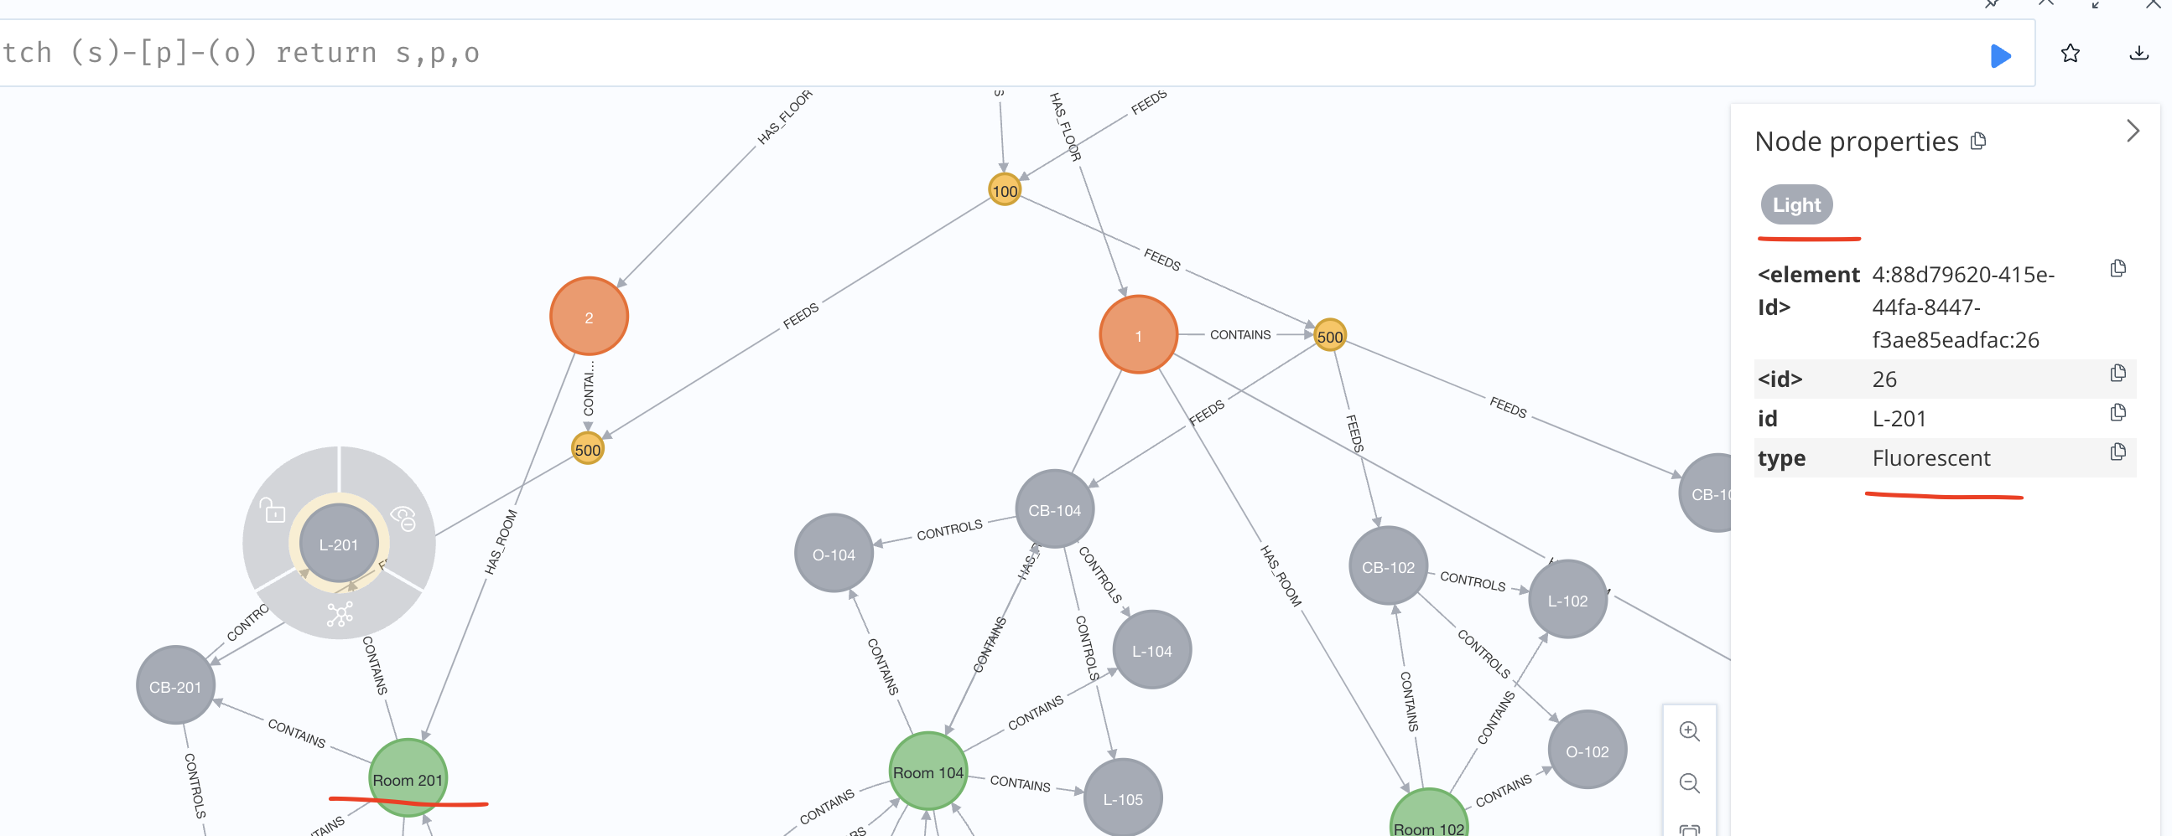
Ollama + RAG = AI Assistant
Question #1 : get all the Light devices and display the room, Light type and Light type counter
Check if the assistant is right for: Room 201 | Fluorescent | 1

Slide 12

Ollama + RAG = AI Assistant

Slide 13
Ollama + RAG = AI Assistant
Answer:
Record<{roomName: "Room 104", deviceLabel: "Sensor", deviceCount: 3}>
Record<{roomName: "Room 104", deviceLabel: "Light", deviceCount: 2}>
Record<{roomName: "Room 101", deviceLabel: "CircuitBreaker", deviceCount: 1}>
Record<{roomName: "Room 101", deviceLabel: "Light", deviceCount: 1}>
Record<{roomName: "Room 101", deviceLabel: "Outlet", deviceCount: 1}>
Record<{roomName: "Room 101", deviceLabel: "Sensor", deviceCount: 1}>
Record<{roomName: "Room 102", deviceLabel: "CircuitBreaker", deviceCount: 1}>
Record<{roomName: "Room 102", deviceLabel: "Light", deviceCount: 1}>
Record<{roomName: "Room 102", deviceLabel: "Outlet", deviceCount: 1}>
Record<{roomName: "Room 201", deviceLabel: "CircuitBreaker", deviceCount: 1}>
Record<{roomName: "Room 201", deviceLabel: "Light", deviceCount: 1}>
Record<{roomName: "Room 201", deviceLabel: "Outlet", deviceCount: 1}>
Record<{roomName: "Room 201", deviceLabel: "Sensor", deviceCount: 1}>
Record<{roomName: "Room 104", deviceLabel: "CircuitBreaker", deviceCount: 1}>
Record<{roomName: "Room 104", deviceLabel: "Outlet", deviceCount: 1}>
Question #2: count the devices from each room and display the room name and device node label and count in descending order

Slide 14
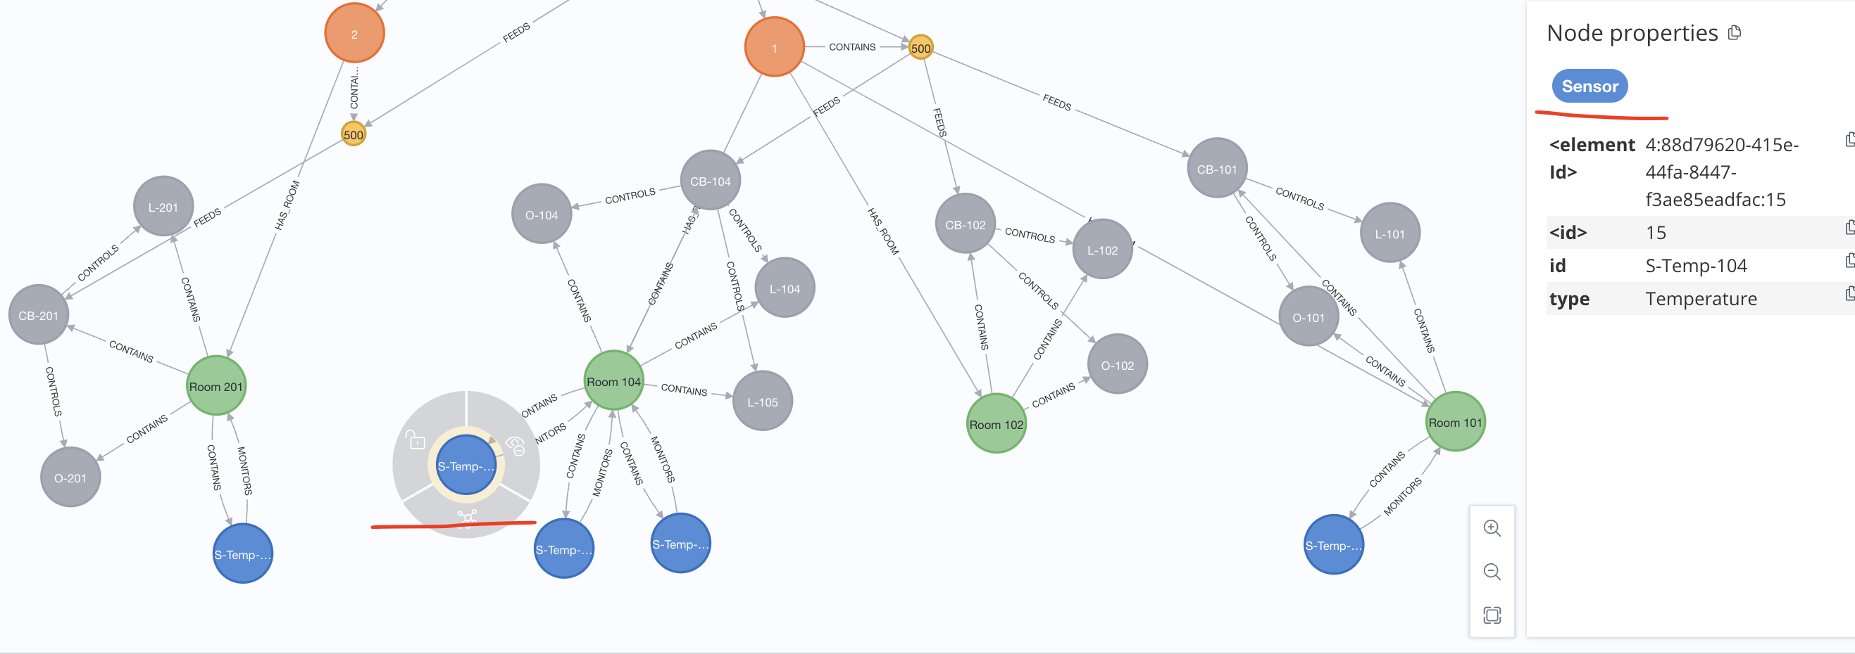
Ollama + RAG = AI Assistant
Check if the AI assistant is right for : Room 104 has 3 sensors?
Question #2: count the devices from each room and display the room name and device node label and count in descending order

Slide 15
Ollama + RAG = AI Assistant – how it works?
// Create Locations CREATE (b:Building {name: 'TechTower'}) CREATE (f1:Floor {number: 1}) … CREATE (r104:Room {name: 'Room 104'}) // Location Hierarchy … CREATE (f1)-[:HAS_ROOM]->(r104)
CREATE (sensor104:Sensor {id: 'S-Temp-104', type: 'Temperature'}) CREATE (sensor105:Sensor {id: 'S-Temp-105', type: 'Temperature'}) CREATE (sensor106:Sensor {id: 'S-Temp-106', type: 'Temperature'}) CREATE (light104:Light {id: 'L-104', type: 'LED'}) CREATE (light105:Light {id: 'L-105', type: 'LED’})
….
CREATE (r104)-[:CONTAINS]->(sensor104) CREATE (r104)-[:CONTAINS]->(sensor105) CREATE (r104)-[:CONTAINS]->(sensor106) CREATE (r104)-[:CONTAINS]->(light104) CREATE (r104)-[:CONTAINS]->(light105)

Slide 16
Ollama + RAG = AI Assistant – how it works?
Step 1: the question is send to Ollama. The context is enhanced with the DB schema
question = "count the devices from each room and display the room name and device node label and count in descending order"

Slide 17
Ollama + RAG = AI Assistant – how it works?
Step 1: the question is send to Ollama. The context is enhanced with the DB schema in an agentic style:
template = """ You are a Neo4J Cypher query designer. Given this Neo4J schema description. <schema> Nodes; - type: Building, properties: + [String] name - type: Floor, properties: + [Number] number - type: Room, properties: + [String] name - type: CircuitBreaker, properties: + [String] name - type: Light, properties: + [String] type + [String] name + [Number] power - type: Outlet, properties:

Slide 18

Ollama + RAG = AI Assistant – how it works?

Slide 19
Ollama + RAG = AI Assistant – how it works?
Step 1: the question is send to Ollama. The context is enhanced with the DB schema in an agentic style:
Reduce hallucinations and narrow the response:
<rule> - Use only the information based on the <schema> to provide accurate answers for the <question>. - If you don't know, or the <schema> does not provide enough information, answer with "I don't know". - Always limit the query to 100 most relevant results. - The cypher must always return node properties and not the node itself. For example: + this one is not expected: `MATCH (u:User) RETURN u LIMIT 100` + this one is expected: `MATCH (u:User) RETURN u.userId, u.username, u.registeredAt, u.displayName LIMIT 100` - Provide only Cypher query. No descriptive text. - Your output must be in one line of plain text, not formatted as code. - Always answer with one Cypher query. If more than one query exists, return only the first one. For example: + this one is not expected: `MATCH (u:User) WHERE u.displayName='brucewayne'; MATCH (u:User) WHERE u.username='batman'; ` + this one is expected: `MATCH (u:User) WHERE u.displayName='brucewayne'` - remove the <think> node from the response <rule>

Slide 20
Ollama + RAG = AI Assistant – how it works?
Step 2: return the Neo4J cypher query:
Model: gpt-oss:20b
Loading...
MATCH (r:Room)-[:CONTAINS]->(d) RETURN r.name AS roomName, labels(d)[0] AS deviceLabel, count(d) AS deviceCount
ORDER BY deviceCount DESC LIMIT 100
Duration: 22.148921500s
Connection established.

Slide 21
Ollama + RAG = AI Assistant – how it works?
Step 3: Run the cypher query against the Neo4j DB
Result:
Record<{roomName: "Room 104", deviceLabel: "Sensor", deviceCount: 3}>
Record<{roomName: "Room 104", deviceLabel: "Light", deviceCount: 2}>
Record<{roomName: "Room 101", deviceLabel: "CircuitBreaker", deviceCount: 1}>
Record<{roomName: "Room 101", deviceLabel: "Light", deviceCount: 1}>
Record<{roomName: "Room 101", deviceLabel: "Outlet", deviceCount: 1}>
Record<{roomName: "Room 101", deviceLabel: "Sensor", deviceCount: 1}>

Slide 22
Neo4J - other use cases and capabilities
Step 4: sent the records again to Ollama with an agentic template.
Here we can config an output format, so that the output can be exported in different formats
E.g: template = """ Use the given knowledge-graph to answer the question. The knowledge-graph contains a CSV formatted text with relevant data. If you don't know the answer based on given knowledge-graph, just say that you don't know. --- This knowledge-graph contains data about a building management system. <knowledge-graph> {knowledgeGraphContext} <knowledge-graph> --- <question> {question} <question>

Slide 23
Step 5: Final response from Rag:
**Device counts by room (sorted by count descending)**
| Room | Device Label | Count |
|-----------|----------------|-------|
| **Room 104** | Sensor | 3 |
| | Light | 2 |
| | CircuitBreaker | 1 |
| | Outlet | 1 |
| **Room 101** | CircuitBreaker | 1 |
| | Light | 1 |
| | Outlet | 1 |
| | Sensor | 1 |
| **Room 102** | CircuitBreaker | 1 |
| | Light | 1 |
| | Outlet | 1 |
| **Room 201** | CircuitBreaker | 1 |
| | Light | 1 |
| | Outlet | 1 |
| | Sensor | 1 |

Slide 24


Slide 25
Neo4J
///////////////one node- discover the network topology //find connections around one node, by hierarchy level, unidirectional match path=(b:Building)-[*1..3]-(r) return path //one node:find connections around one node, by hierarchy level, directional match path=(b:Building)-[*1..1]->(r) return path /////////////////////////////////////////////////// ////////////////two nodes: //find all connections between 2 nodes match path=(b:Building)-[*1..4]-(r:Room) return path //find shortest path between 2 nodes match path=shortestPath((b:Building)-[*1..4]-(r:Room)) return path /////////////////////////////////////////////////// //recommendation system match path1=(s1:Sensor{id:"S-Temp-101"})-[:MONITORS]->(r1:Room)<-[:HAS_ROOM]-(f1:Floor{number:1}), path2= (s2:Sensor)-[:MONITORS]->(r2:Room)<-[:HAS_ROOM]-(f1:Floor{number:1}) return path1,path2

Slide 26
Neo4J
find shortest path between 2 nodes= can be used for energy load balancing (some users have too much energy, other have none) e.g: photovoltaic systems, energy grid, gas grid, etc
find shortest path between 2 nodes= can be used to find another (near) energy source (node) in case of primary energy source is failing e.g: Miroslava area //recommendation system= can be used to find alternative energy sources between neighbourhoods match, can find similar configurations of a device in another location:
E.g: path1=(s1:Sensor{id:"S-Temp-101"})-[:MONITORS]->(r1:Room)<-[:HAS_ROOM]-(f1:Floor{number:1}), path2= (s2:Sensor)-[:MONITORS]->(r2:Room)<-[:HAS_ROOM]-(f1:Floor{number:1}) return path1,path2

Slide 27
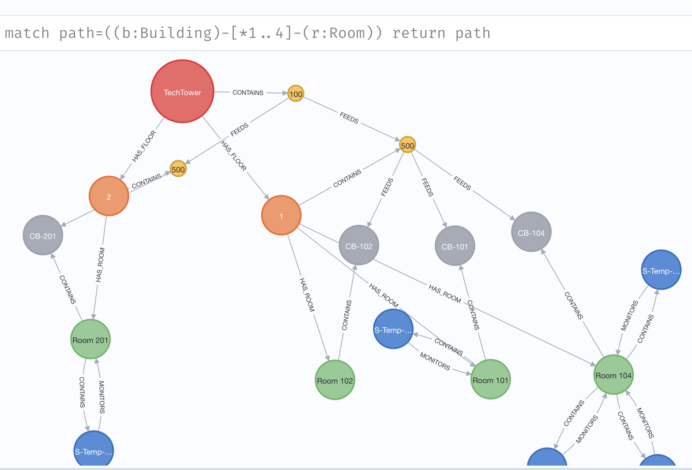
Neo4J

Slide 28
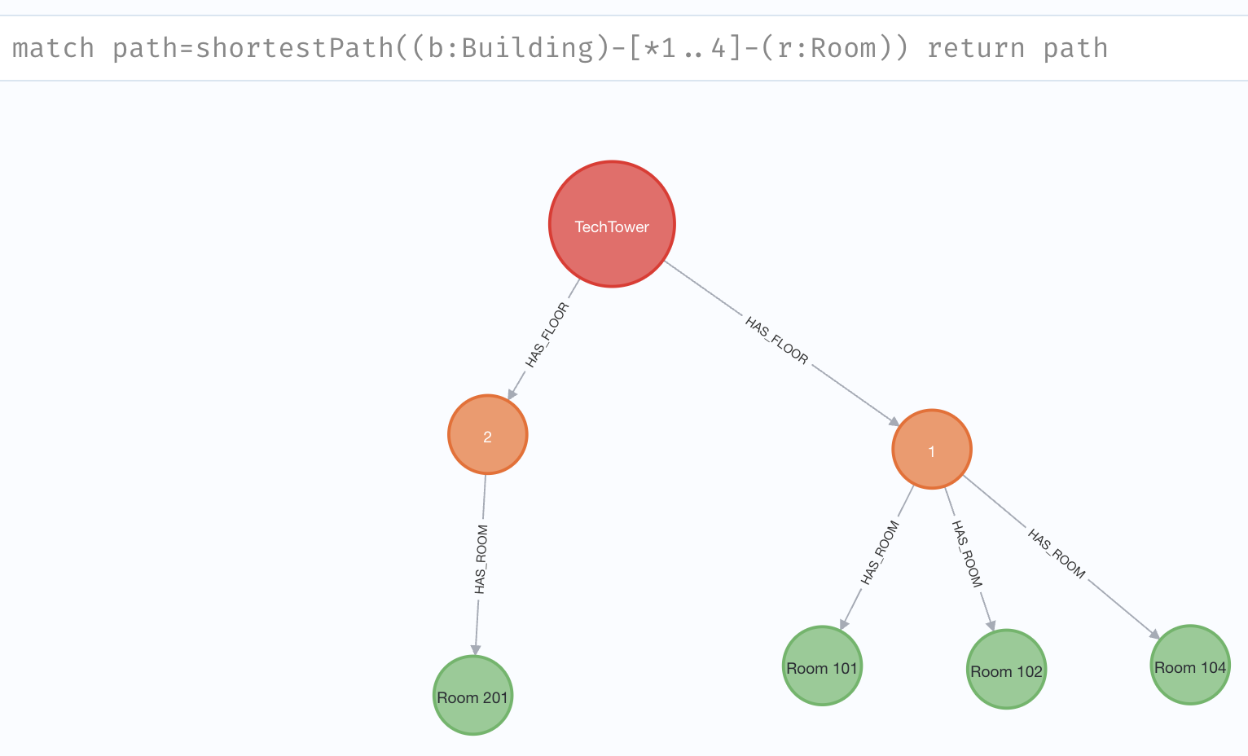
Neo4J

Slide 29
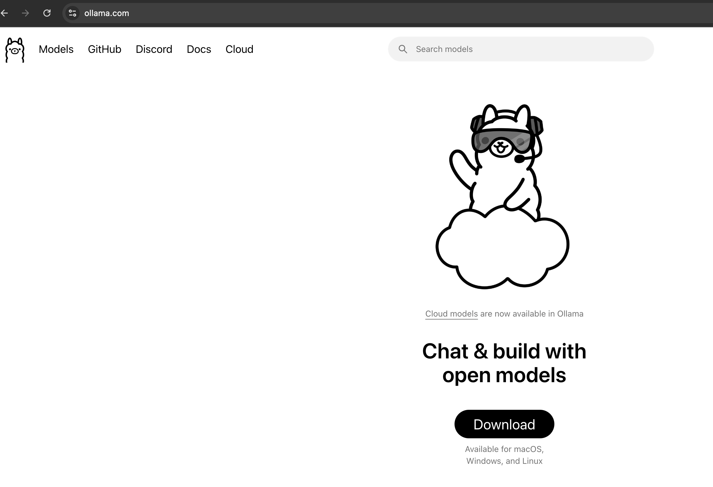
Ollama= download free LLM models (offline mode/ no Internet needed= full privacy)

Slide 30
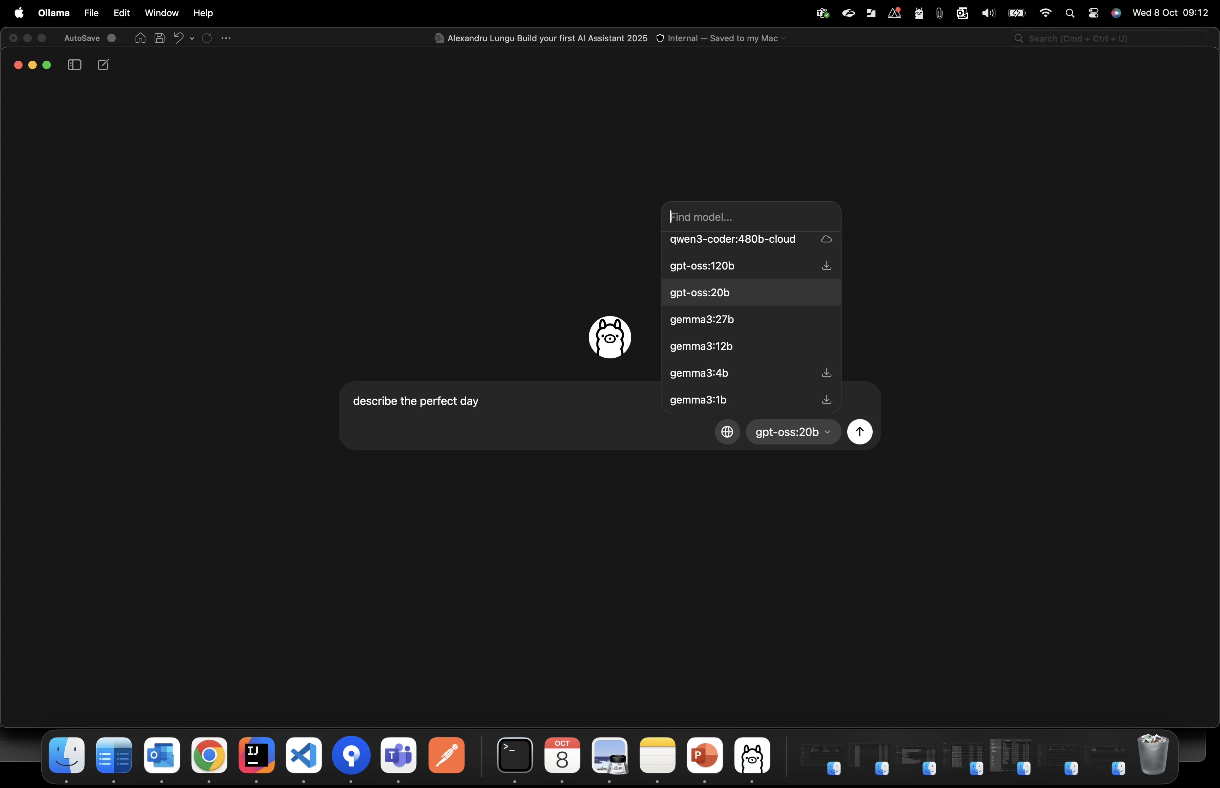
Ollama= download free LLM models (offline mode/ no Internet needed= full privacy)

Slide 31

Questions ?
Presentation link: https://tinyurl.com/ai-eon-2025
Alexandru Lungu
alexandru.lungu@eon.com
https://github.com/alexlungu10/my-presentations/tree/main/2025

Slide 32

Thank you for your presence.
Presentation link: https://tinyurl.com/ai-eon-2025
Alexandru Lungu
alexandru.lungu@eon.com

Slide 33

Thank you

